Slide 1

ALY6980 - Midterm Presentation
Group 8
Akshay Ganesh Hanchate, Vidhi Rajeshbhai Mistry, Shengyao Xu & Hrithick Gokul Yeddula
Prof. Roy Wada
02/20/2025

Slide 2
INTRODUCTION
Boston 311 Syringe Request Analysis
Background:
  The opioid crisis in Boston is a critical public health issue.
  The project aims to analyze and visualize Boston 311 syringe request data to enhance harm reduction strategies.
Research Goals:
  Identifying high-risk areas and optimize resource allocation.
  Using geospatial analysis and predictive modeling for policy recommendations.
  Enhancing public health responses with data-driven decision-making.
Significance:
  Studies show that data-driven public health interventions improve harm reduction (Aguilera et al., 2021).
  Predictive analytics help in forecasting syringe disposal trends, allowing proactive resource management.

Slide 3
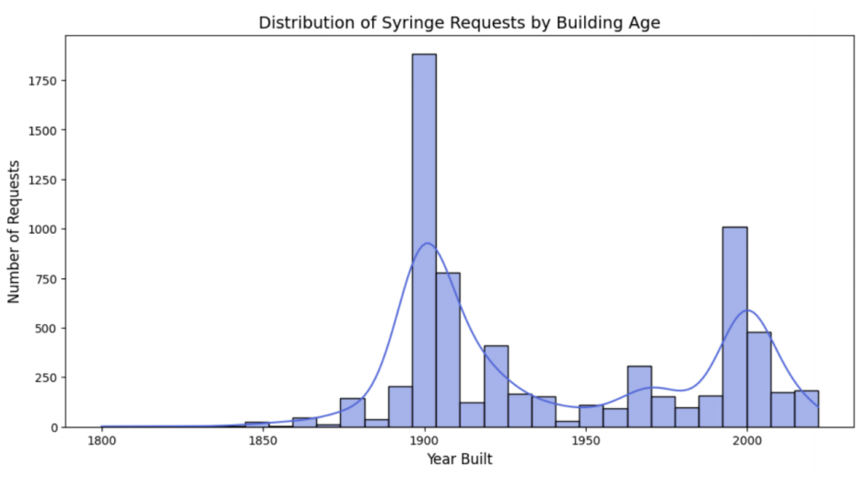
Exploratory Data Analysis
Distribution of Syringe Requests by Building Age
The histogram visualizes the relationship between the age of buildings and the number of syringe requests.
Two noticeable peaks: around 1900 and 1990.
The highest peak corresponds to buildings from around 1900, indicating that older buildings may be more associated with syringe requests.
This insight can be particularly used to allocate resources, such as public disposal bins and harm reduction programs, to the most affected neighborhoods.

Slide 4
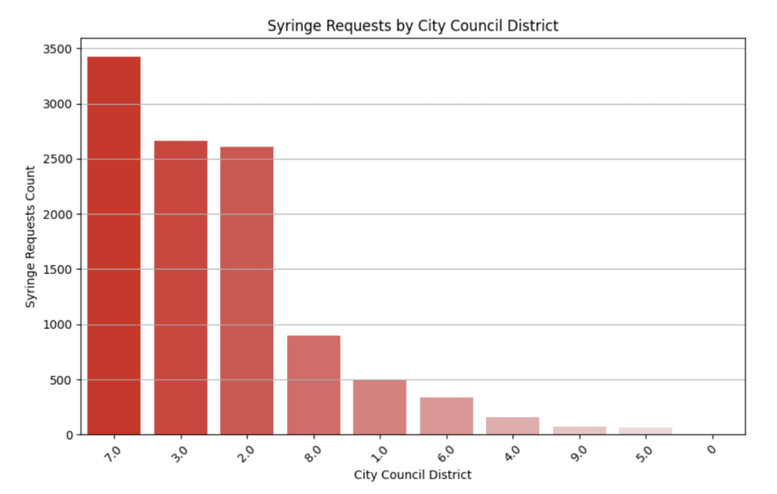
Exploratory Data Analysis
Syringe Requests by City Council District
The bar chart shows the distribution of syringe requests across different City Council districts.
District 7 (Roxbury) has the highest number of requests, followed by Districts 3(Downtown) and 2(Allston-Brighton-Kenmore).
This suggests that certain areas have a significantly higher need for syringe-related services.
Here, this insight can be used to:
Deploy mobile health units
Educate residents on safe syringe disposal and harm reduction services
Improve city services by analyzing response delays and optimizing the dispatch of cleanup teams.

Slide 5
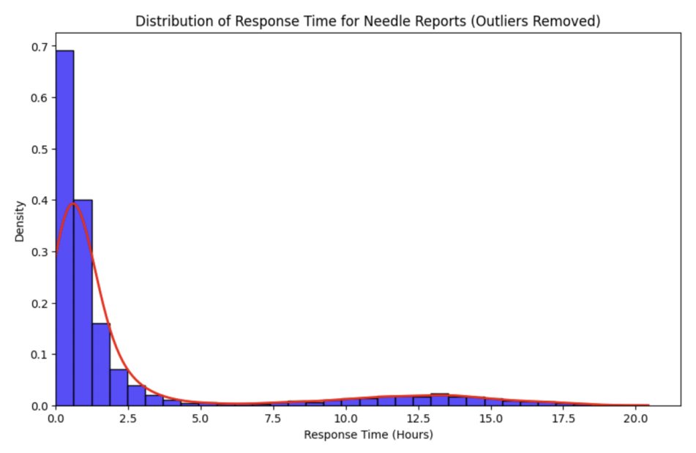
Exploratory Data Analysis
Distribution of Response Time for Needle Reports
The histogram with a density curve shows the distribution of response times for needle pickup requests.
The majority of responses occur within the first two hours, with a sharp decline as time increases.
Some reports take longer, but these are less frequent.
Most needle reports are addressed promptly, but some outliers suggest occasional delays that should be investigated.

Slide 6
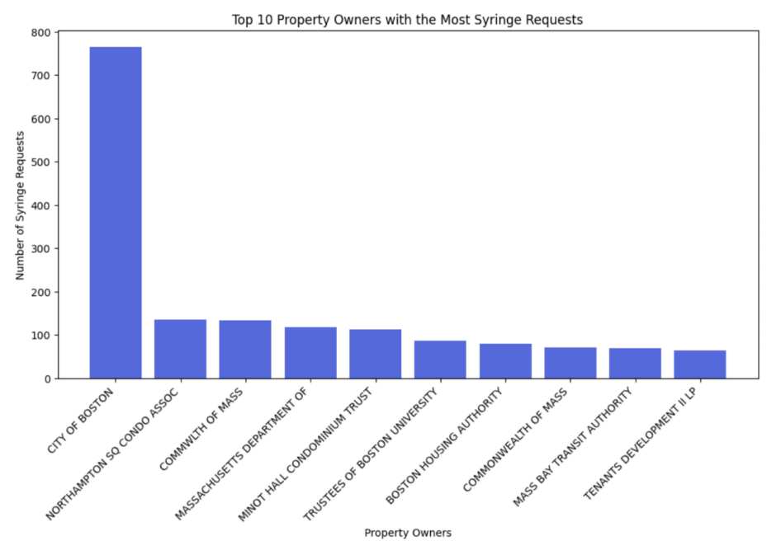
Exploratory Data Analysis
Top 10 Property Owners with the Most Syringe Requests
The bar chart highlights the property owners receiving the most syringe-related service requests.
The City of Boston has the highest number of requests by a significant margin.
Other notable property owners include universities and public agencies.
This suggests that public authorities and large institutions play a crucial role in managing syringe disposal and harm reduction efforts.

Slide 7
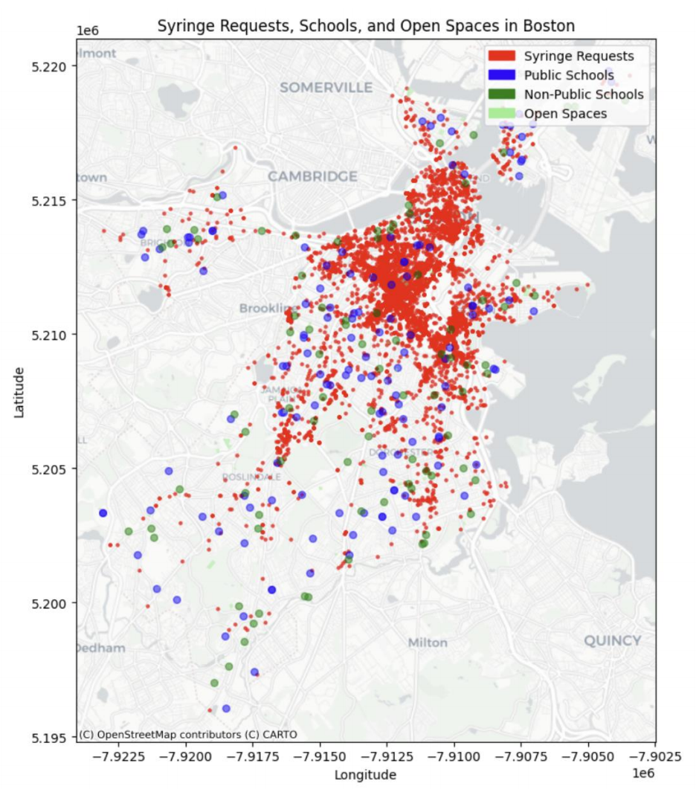
Exploratory Data Analysis
Syringe Requests, Schools, and Open Spaces in Boston
The map overlays syringe request locations (red dots) with the locations of public schools (blue), non-public schools (dark green), and open spaces (green).
There is a high concentration of syringe requests in specific areas, just a few of them are near schools and public spaces.
This suggests that syringe disposal issues are localized and not directly impacting educational institutions or public areas.

Slide 8
Predictive Models
Utilized advanced analytics techniques to identify high-risk neighborhoods and predict future trends in service requests, enabling targeted interventions.
K-Means Clustering
Purpose: Identify distinct clusters of neighborhoods based on risk factors such as crime rates, emergency calls, and socio-economic indicators.
Process: Apply the K-Means clustering algorithm to segment neighborhoods into groups. This helps in understanding different risk profiles and tailoring safety measures appropriately.
SARIMA Time-Series Forecasting
Purpose: Predict future trends in community service requests, such as public safety or maintenance needs.
Process: Develop a SARIMA (Seasonal AutoRegressive Integrated Moving Average) model to forecast the volume of requests. This model considers both seasonal variations and underlying trends, providing a robust prediction mechanism.

Slide 9
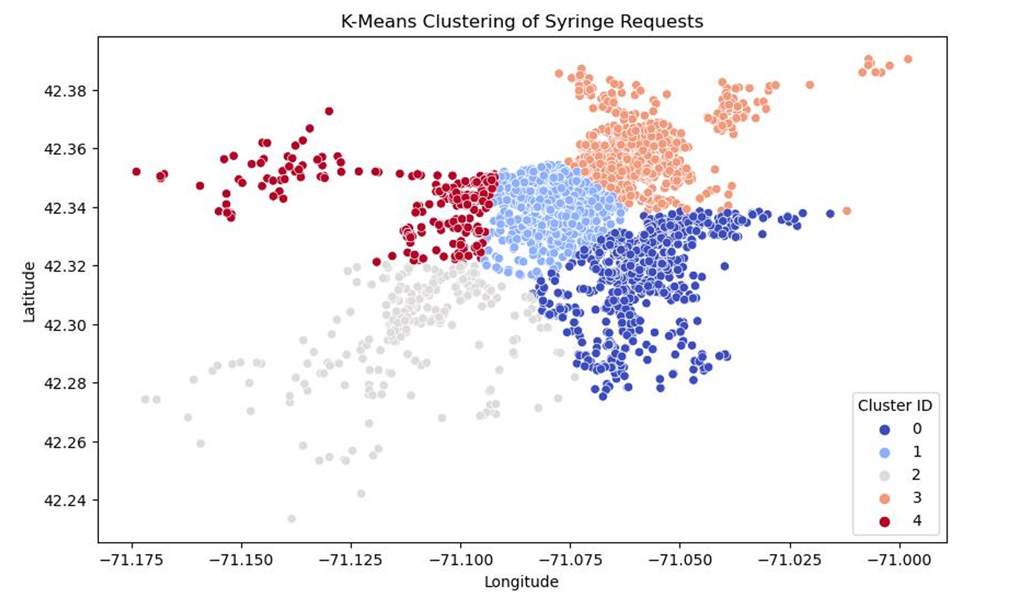
K-Means Clustering
This map uses K-Means machine learning to segment syringe disposal requests into five clusters, with each color indicating a different group of similar locations.
Clusters show varied concentrations: dense clusters indicate hotspots, border zones suggest transitional areas needing more services, and distant clusters highlight isolated cases for targeted interventions.
This analysis aids in resource allocation by prioritizing high-need zones for syringe disposal, informing policy on bin placement and outreach, and guiding public health strategies for effective harm reduction.
Next steps include increasing disposal stations in high-density areas, monitoring cluster trends for shifts or growth, and leveraging this analysis for public health planning and harm reduction efforts.

Slide 10
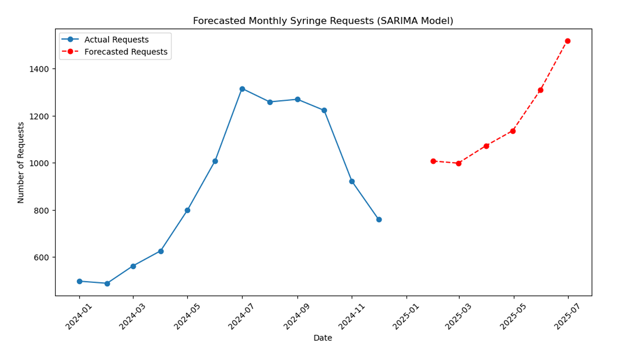
SARIMA Time-Series Forecasting
The blue line shows actual monthly syringe requests, while the red dashed line forecasts future requests using SARIMA modeling.
Historical data reveals seasonal trends in syringe requests, with forecasts predicting increased disposal needs and sharp growth in demand for future months.
This analysis enables proactive planning, optimal resource allocation, and policy impact assessment, helping city officials prepare for and respond to changing syringe disposal needs.
Next steps include scaling up disposal services to meet rising demand, monitoring the impact of policy changes on trends, and using forecasts to shape long-term harm reduction strategies.

Slide 11
Next Steps
Enhancing Data Quality and Predictive Modeling:
Investigate cases marked as “open” despite having closure photos uploaded.
Compare timestamps on closure photos with reported resolution times.
Fine tune Predictive Models to get more accurate results.
Developing Interactive Visualizations:
Build a Power BI dashboard for real-time monitoring and decision-making.
Enable policymakers to track syringe disposal trends dynamically.

Slide 12
Conclusion
Key Findings:
Syringe requests peak seasonally, particularly in high-risk areas.
District 7 accounts for the highest number of requests (~33%).
Strong correlation between syringe requests and older building clusters.
Impact of Predictive Analysis:
K-Means clustering identifies high-risk neighborhoods for targeted interventions.
SARIMA model forecasts increasing demand, guiding resource allocation.
Final Takeaways:
Data-driven insights improve public health interventions.
Predictive models support evidence-based policy decisions.

Slide 13
References
Aguilera, J., Baxter, M., & Tapia, A. H. (2021). Spatial analysis of urban syringe disposal
patterns: Implications for public health interventions. Journal of Urban Health, 98(4),
567-582.
Buchanan, D., Shaw, S., & Ford, A. (2020). Predictive analytics in public health: Using
machine learning to identify high-risk areas for needle disposal. Health Informatics
Journal, 26(3), 1982-1996.
Klein, A. Z., & Park, H. S. (2022). Examining the relationship between opioid crisis and
syringe disposal sites: A statistical approach. International Journal of Drug Policy, 103,
180-197.
Chen, H., Chiang, R. H. L., & Storey, V . C. (2012). Business Intelligence and Analytics:
From Big Data to Big Impact. MIS Quarterly, 36(4), 1165–1188.
Guy, G. P., Zhang, K., Bohm, M. K., Losby, J., Lewis, B., Young, R., Murphy, L. B., &
Dowell, D. (2017). Vital Signs: Changes in Opioid Prescribing in the United States,
2006–2015. MMWR. Morbidity and Mortality Weekly Report, 66(26), 697–704.

Slide 14
Contribution
Akshay Ganesh Hanchate:
Conducted EDA to identify key trends and data discrepancies. Discovered critical insights, such as a high concentration of syringe disposals at intersections. Addressed inconsistencies in case status reporting to enhance data accuracy. Developed a SARIMA time-series model to predict future syringe disposal trends, providing a data-driven approach for resource planning and harm reduction strategies.
Vidhi Rajeshbhai Mistry:

Slide 15
Contributions
Akshay Ganesh Hanchate:
Conducted EDA to identify key trends and data discrepancies. Discovered critical insights, such as a high concentration of syringe disposals at intersections. Addressed inconsistencies in case status reporting to enhance data accuracy. Developed a SARIMA time-series model to predict future syringe disposal trends, providing a data-driven approach for resource planning and harm reduction strategies.
Vidhi Rajeshbhai Mistry:
A. Performed EDA on 10,730 syringe requests, identifying District 2, 7, and 3 as high-risk areas.
B. Created a heatmap showing syringe disposal hotspots, with District 2 having 3,915 requests (highest in Boston).
C. Developed a regression model with an R² of 0.85, indicating strong predictive power.
Key Findings:
Population density (coef: 1.2): Higher population density leads to an increase in syringe requests.
Proximity to health services (coef: -0.8): Areas closer to health services tend to have fewer syringe requests.

Slide 16
Contributions
Shengyao Xu:
Shengyao contributed to data cleaning, EDA, and SARIMA model in syringe requests. He supports the final deliverable by providing data-driven insights for policy recommendations and aiding forecasting efforts helping identify priority intervention areas, improve response efficiency, and support strategic planning for public health initiatives.
Hrithick Gokul Yeddula:
Hrithick refined the parameters of the SARIMA model to enhance the accuracy of our forecasts. This involved detailed statistical analysis and model optimization. Hrithick also focused on data validation processes, ensuring the reliability and integrity of the data inputs. Additionally, He analyzed trends and patterns within the data, which helped in identifying critical intervention areas for public health planning.

